Slide 1
ICANN 76 Cancún
DID to DNS with DNSSEC ☺
CIRA
March 15, 2023
Presented By
Jacques Latour – CIRA – in person
Jesse Carter – CIRA - remote

Slide 2

ENHANCING THE DIGITAL TRUST INFRASTRUCTURE USING DNS & DNSSEC
When an entity is presented with a verifiable claim,
there are three things they will want to ensure:
That a claim hasn’t been altered/falsified at any point in time
(Cryptographic verifiability, Verifiable Data Registries - VDRs)
?
That a claim has accurate representation
(Authentication, DID Discovery/mapping within DNS)
?
That a claim has authority
(Authorization, Trust Registries/trust lists)

Slide 3
USING DIGITAL CREDENTIALS
Here’s the story
Chioma from Gatineau, Quebec is travelling in Japan. She goes to a bar where she is asked to prove she is 20 years or older (the legal drinking age in Japan). Chioma produces a proof of age claim with her driver’s licence digital credential, which was issued to her by Quebec’s driver’s licence issuer.
The bar in Japan has never heard of Quebec, but its verifying technology can see that the claim is made from a Canadian based governmental organization. This triggers:
the bar’s verifying technology to reference Japan’s apex trust registry,
which then using DNS can reference Canada’s apex trust registry,
which can then “route the call” to Quebec trust registry,
which can in turn confirm that Quebec’s driver licence issuer is both a legitimate entity and has the authority to issue a proof of age claim (via a driver’s licence).

Slide 4
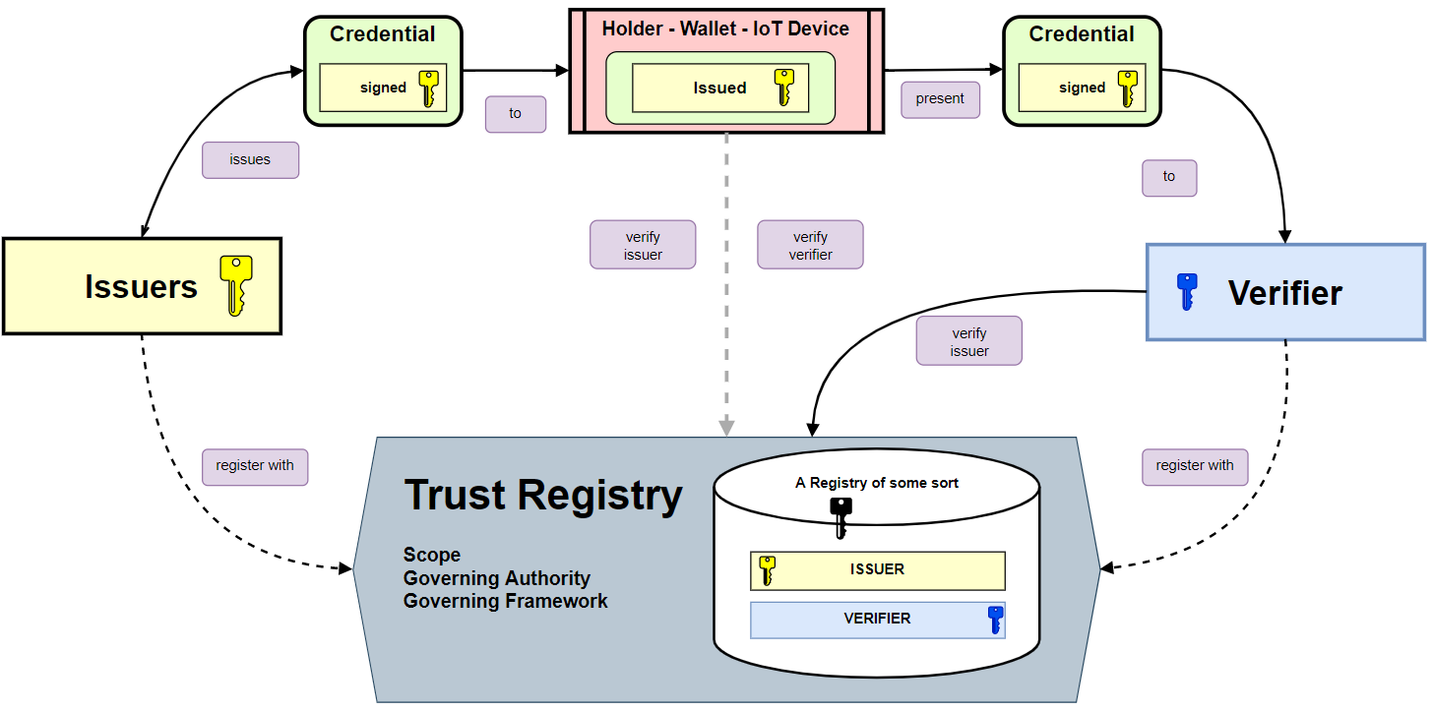
The Digital Credential Ecosystem
A Driver’s
License
Claim that
she’s 20 years+
Chioma
Quebec
Government
A bar in
Japan
A bunch of
trust registries

Slide 5
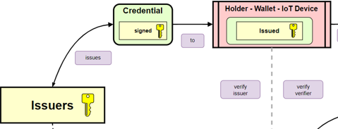
Where’s the beginning?
Let’s start with verifiable credentials
The individual, in this case Chioma, owns a digital wallet capable of holding and presenting a verifiable credential.
A verifiable credential in this example is based on the W3C Verifiable Credential Data Model v1.1. (https://www.w3.org/TR/vc-data-model/)
The issuer, tr-demo.ciralabs.ca, issues the credential to Chioma’s digital wallet by proxy of the DID they control
did:sov:danube:XWfvq6uyAjBUbg4hBBP3vM.

Slide 6
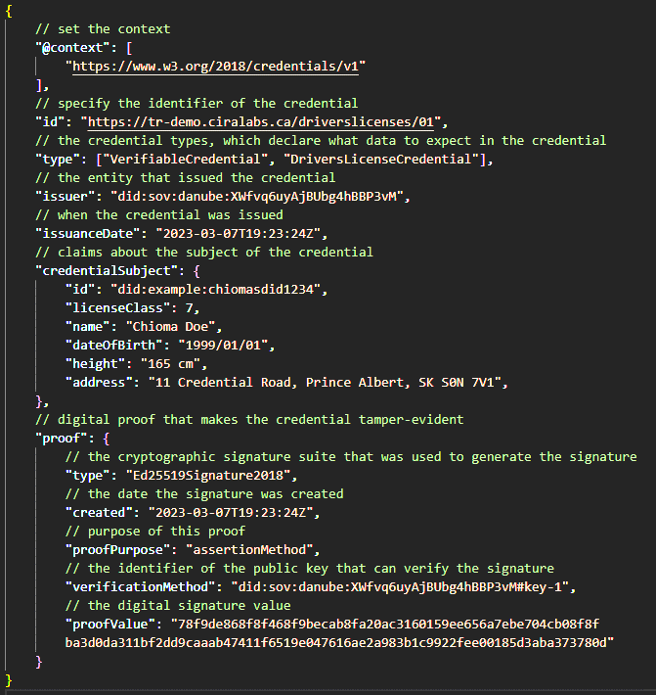
The DIGITAL Credential
The credential contains metadata about the subject, Chioma, and the claims it is representing (could be a degree, age, driver’s license class, etc.).
The credential points to an issuer, did:sov:danube:XWfvq6uyAjBUbg4hBBP3vM.
The credential contains a digital proof, a cryptographic signature of the credential content ensuring its integrity.
The verificationMethod points to a public key which can be used to verify that signature.

Slide 7
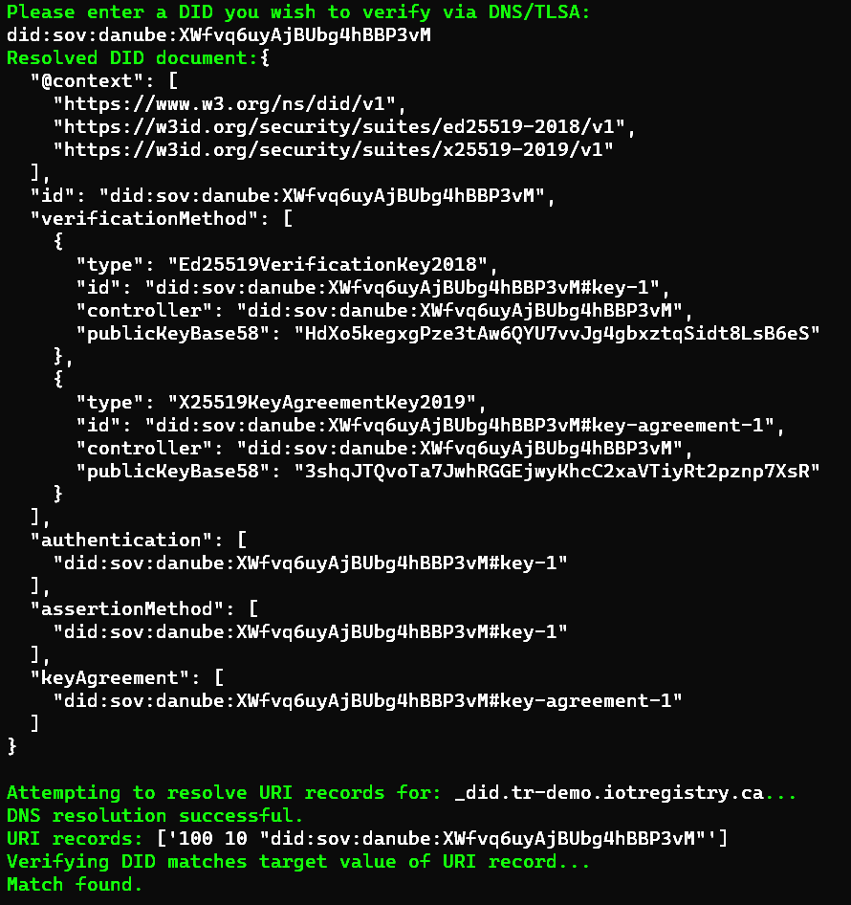
Verifying the verifiable Credential
To verify the credential, the verifier must first resolve the public key in the proof section.
In this case, the verificationMethod points to a key held by the same DID which issued the credential: did:sov:danube:XWfvq6uyAjBUbg4hBBP3vM
Resolving that DID will yield a DID Document, a set of data describing the DID subject.
TRY: https://dev.uniresolver.io/ DID-URL: did:sov:danube:XWfvq6uyAjBUbg4hBBP3vM

Slide 8
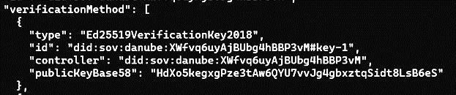
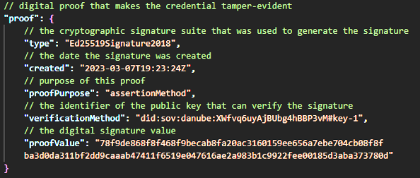
Verifying the verifiable Credential
The resolved DID document contains the public key we need to verify the credential: did:sov:danube:XWfvq6uyAjBUbg4hBBP3vM#key-1
By converting the public key represented in base 58 to hex we get: f716b82bd54ecddb908d804cd031512eb5cb3a5454d0c1024e30b04a88251cff
The signature of the content in the verifiable credential can then be referenced against the public key to determine if that key pair really did sign the credential…

Slide 9
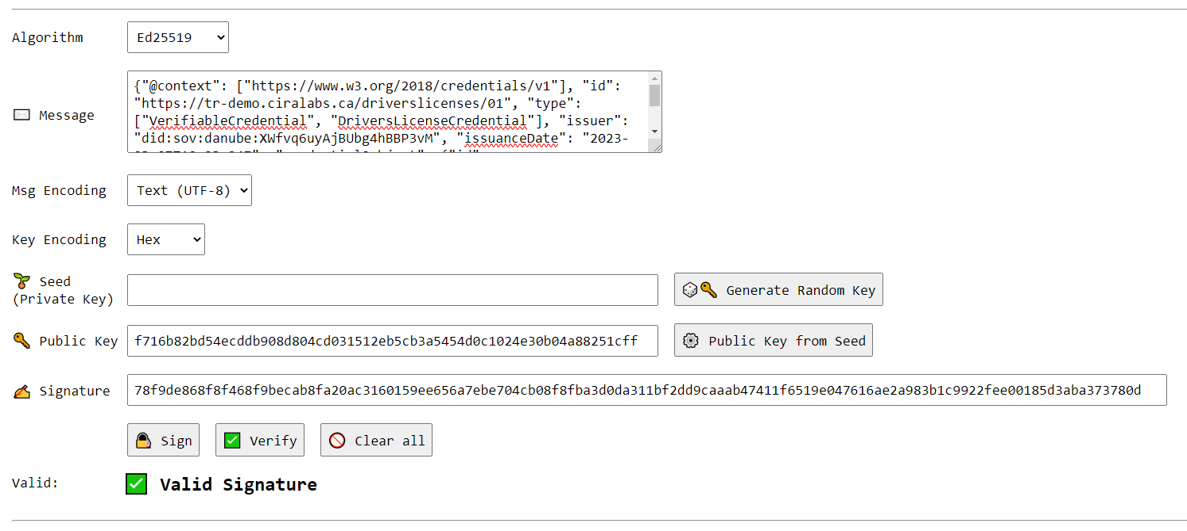
Surprise, It Did!
https://cyphr.me/ed25519_applet/ed.html

Slide 10
With the credential verified, how do we verify the Issuer?
Through the cryptographic verification process we just outlined; we have confirmed that the key pair in possession of did:sov:danube:XWfvq6uyAjBUbg4hBBP3vM did in fact sign and issue the digital credential to Chioma.
But the question remains, how do we verify the issuer, did:sov:danube:XWfvq6uyAjBUbg4hBBP3vM?
Is did:sov:danube:XWfvq6uyAjBUbg4hBBP3vM associated with an organization or entity we trust?
Does did:sov:danube:XWfvq6uyAjBUbg4hBBP3vM have the authority to issue that credential to Chioma?
Where and how do I verify all the above?

Slide 11
The answer is in the DNS…

Slide 12
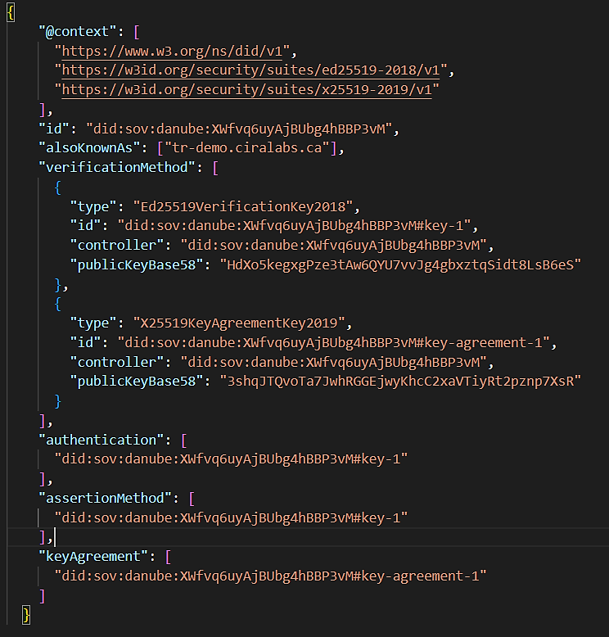
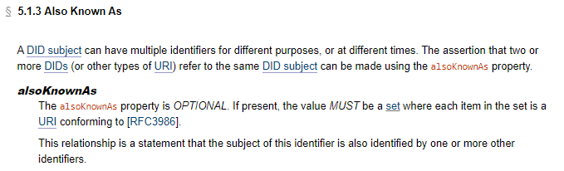
How do we Link aN ISSUER’s DID to a domain?
Unique DID to DNS name mapping
https://www.w3.org/TR/did-core/#also-known-as
As specified in the W3C DID Core spec v1.0, the “alsoKnownAs” field can contain a DID or URI, making the assertion that the URI in the field refers to the same subject.
The “alsoKnownAs” assertion can then be used to indicate under which domain the relevant DNS records (URI and TLSA) for this DID can be found.

Slide 13
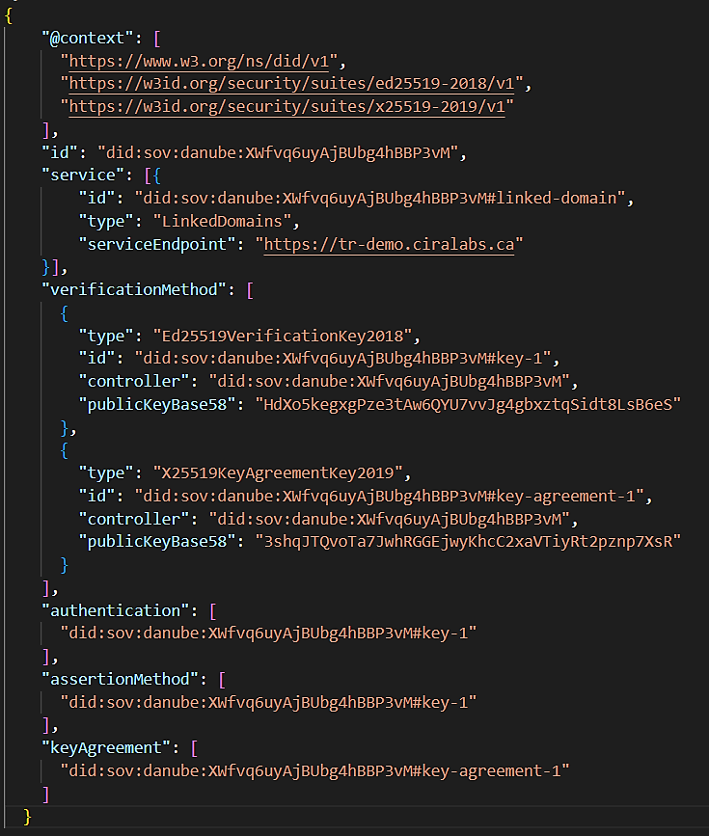
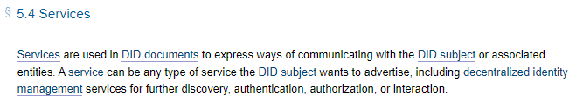
How do we aN ISSUER’s DID TO a domain?
Unique DID to DNS name mapping
https://www.w3.org/TR/did-core/#also-known-as
As specified in the W3C DID Core spec v1.0, the “services” field can be leveraged to indicate a way to communicate with the DID subject or an associated entity.
Like the “alsoKnownAs” assertion, the “services” field can also be used to indicate under which domain the relevant DNS records (URI and TLSA) for this DID can be found.

Slide 14
THE ROLE OF THE issuer
How do we link the domain of the issuer and their DID in DNS?
A URI record allows us to associate a hostname (like tr-demo.ciralabs.ca) to a URI, like did:sov:danube:XWfvq6uyAjBUbg4hBBP3vM.
Through this association, a domain can show which DIDs are under their jurisdiction, in a publicly accessible and resolvable manner.
Ex: URI Record
_did.tr-demo.ciralabs.ca 1 0 “did:sov:danube:XWfvq6uyAjBUbg4hBBP3vM”
But this association with URI records only represents a claim, and a claim needs support. We once again turn to cryptography and the help of TLSA records as support for this claim.
$ dig _did.tr-demo.ciralabs.ca URI

Slide 15
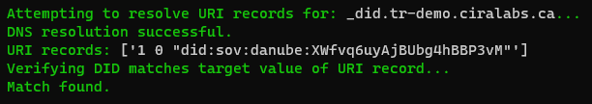

Slide 16
THE ROLE OF THE issuer
We need TLSA records to provide the cryptographic glue holding the association between a domain and a DID together.
A TLSA record allows us to host cryptographic information in the DNS.
These TLSA records will hold the public half of the key pair used by the DID/Issuer to issue a digital credential.
Ex: TLSA Records
_did.tr-demo.ciralabs.ca 3 1 0 F716B82BD54…(public key un-hashed)
_did.tr-demo.ciralabs.ca 3 1 1 8A9E530067D…(sha256 public key hash)
By hosting the public keys in the DNS, the Verifier can not only check the digital credential against the verification method in the DID document, but also against the public keys via DNS as well.
In a similar manor, a cryptographic challenged can be done against both the domain and the DID to ensure they both have access to the associated private key.
$ dig _did.tr-demo.ciralabs.ca TLSA

Slide 17
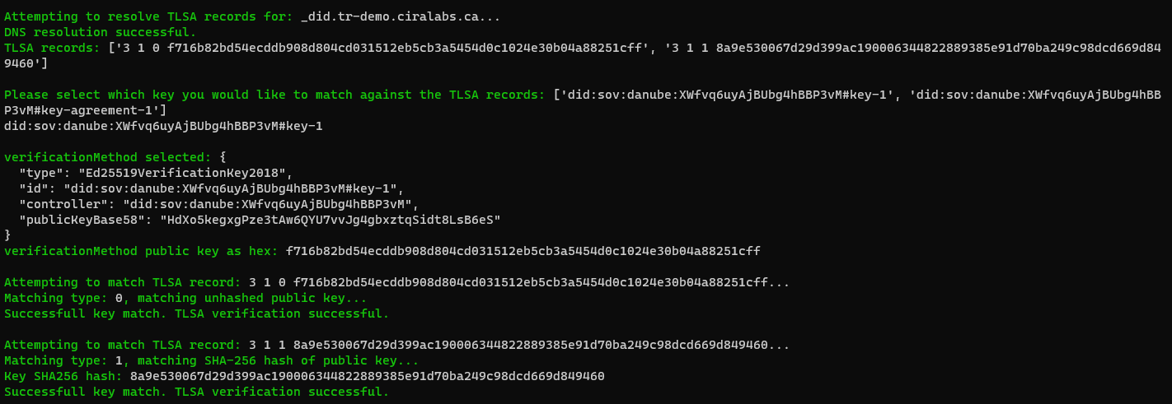

Slide 18
Putting URI and TLSA records Together
By leveraging URI and TLSA records, we create a bi-directional and cryptographic linkage of the DIDs in whatever distributed ledger they reside on to the publicly resolvable DNS and domain they are associated with.
Or in other words;
The Verifier at the bar in Japan can confirm that Chioma’s digital driver’s license was issued by did:sov:danube:XWfvq6uyAjBUbg4hBBP3vM, which is under the control of tr-demo.ciralabs.ca, meaning the driver’s license was ultimately issued by tr-demo.ciralabs.ca.
It is important to note that these technologies can work completely independently of one another or in tandem. The Verifier can leverage just the DNS records, just the DID and distributed ledger (blockchain), or a combination of both to whatever degree they deem necessary.

Slide 19
The Trust Registry Part…

Slide 20
Trust Registry IN DNS
The bar in Japan has confirmed the validity of Chioma’s credential, but now they need to verify the authority of its issuer, tr-demo.ciralabs.ca.
By leveraging the same URI and TLSA records we used before to verify the credential, we can also verify the issuer’s membership in a Trust Registry.
tr-demo.ciralabs.ca hosts a URI record, pointing to a trust registry it is claiming membership in.
Ex: URI Record
_tr.tr-demo.ciralabs.ca 1 0 “trustregistry.ca”
This record indicates that tr-demo.ciralabs.ca is claiming it is registered under trustregistry.ca, the Apex Trust Registry for Canada.
$ dig _tr.tr-demo.ciralabs.ca URI

Slide 21
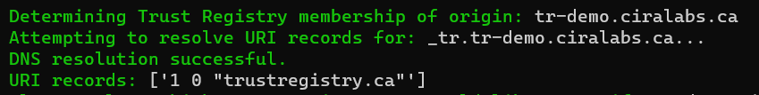

Slide 22
Trust Registry IN DNS
The bar in Japan can now reference that the public key used to issue Chioma’s driver’s licence is hosted by trustregistry.ca.
The verifier can check trustregistry.ca for proof of tr-demo.ciralabs.ca’s membership. We use TLSA records to provide the cryptographic proof of that association by hosting the public key of tr-demo.ciralabs.ca in trustregistry.ca’s zone.
Ex: TLSA Record
tr-demo.ciralabs.ca._tr.trustregistry.ca 3 1 0 (public key un-hashed)
tr-demo.ciralabs.ca._tr.trustregistry.ca 3 1 1 (sha256 hash of public key)
Please note that public key in this case is the same one we used earlier to verify the credential issued by tr-demo.ciralabs.ca to Chioma.
$ dig tr-demo.ciralabs.ca._tr.trustregistry.ca TLSA

Slide 23
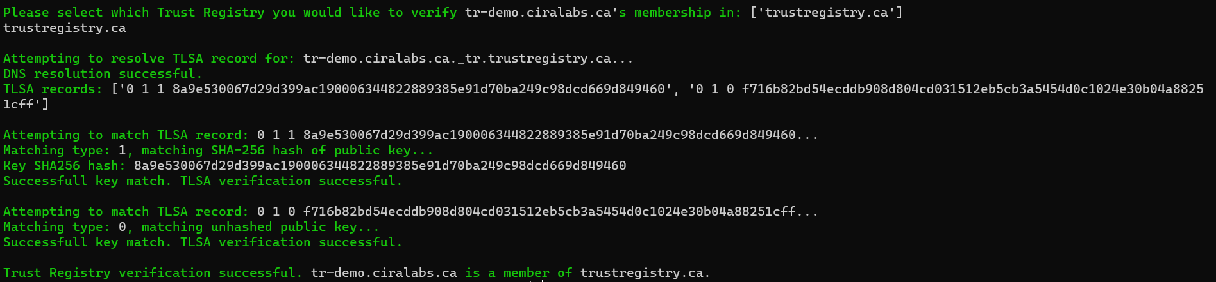

Slide 24
National Trust Registries in collaboration
By having both Canada and Japan’s Apex Trust Registries recognize one another, the chain of trust now spans across the globe and is publicly accessible and resolvable.
But how does the bar know trustregistry.ca is valid? trustregistry.ca would hold a reference to trustregistry.jp, the Apex Trust Registry for Japan, and vice versa. That way the bar can reference their own country’s Apex Trust Registry to navigate the authority and issuance of credentials from another nation.
This allows the root of trust to remain decentralized but still be easy to navigate and reference.
Ex: URI Records
canada._tr.trustregistry.jp 1 0 “trustregistry.ca”
japan._tr.trustregistry.ca 1 0 “trustregistry.jp”
Those trust relationships could be bolstered through the association of PKI (via TLSA records and public keys) or association with DIDs via URI records as required.

Slide 25

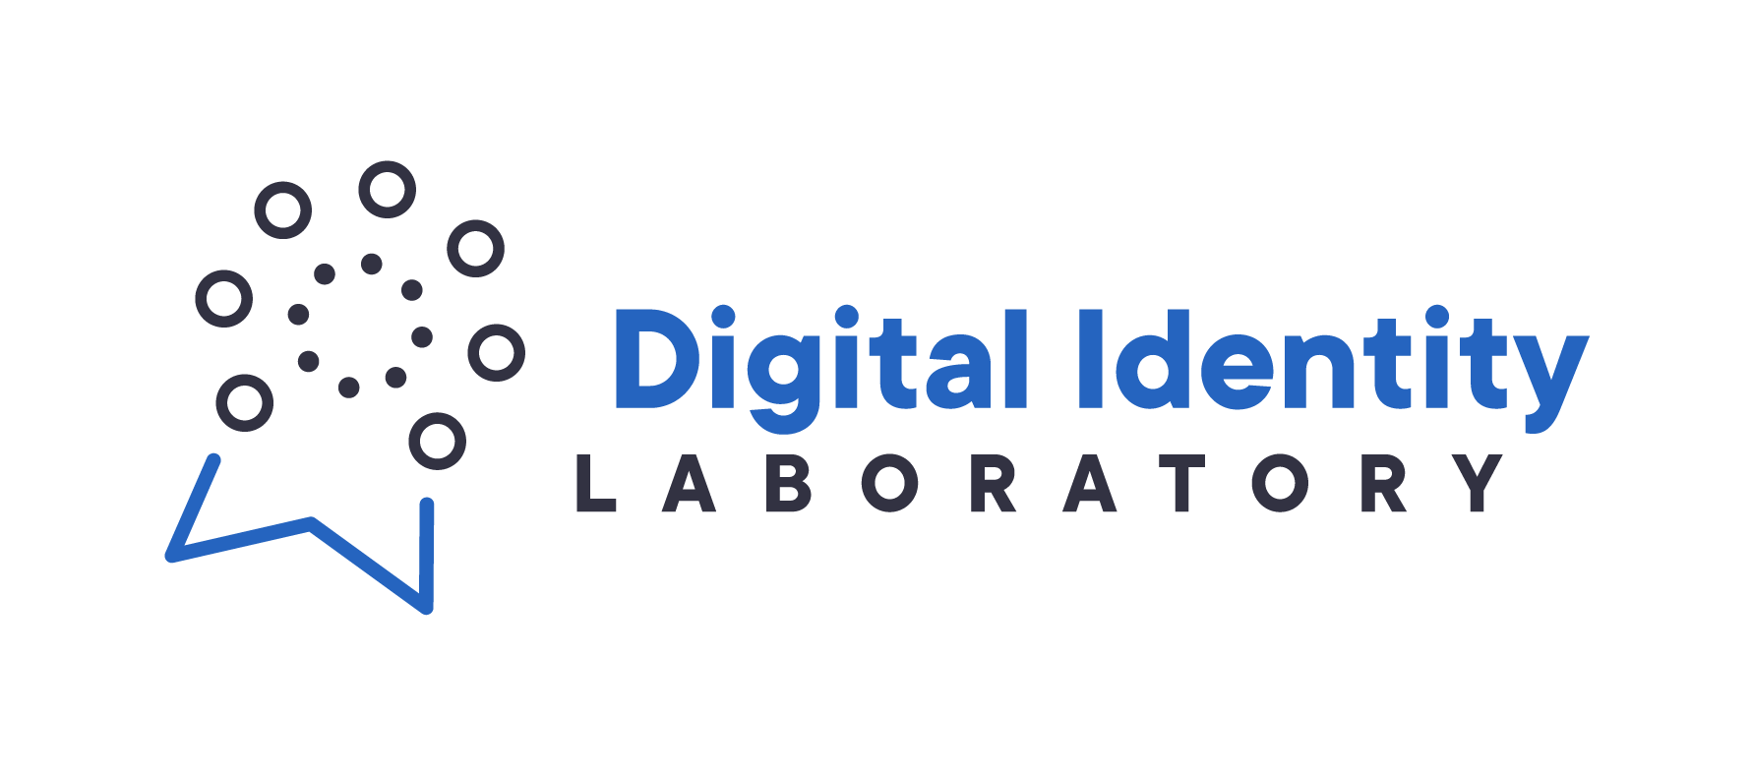

Thank You
https://www.cira.ca/labs

Slide 26
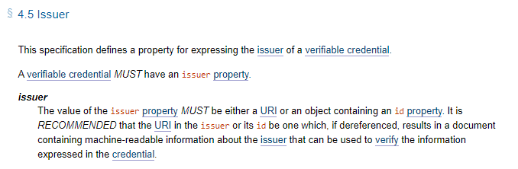
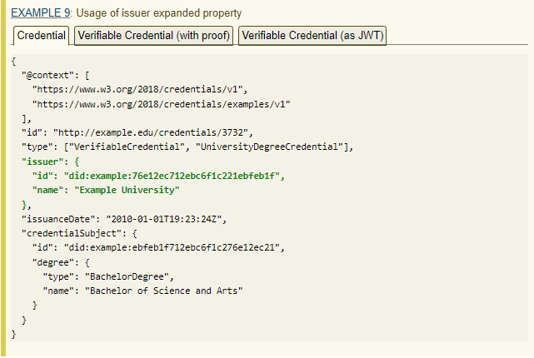
How do we Link a DID or a Digital Credential to a domain?
From the Digital Credential:
https://www.w3.org/TR/vc-data-model/#issuer
As specified in the W3C Verifiable Credential Data Model spec, the “issuer” field can be any object that includes an “id” property.
This means we can include relevant associations like a domain name to this object.
Or, since the only requirement for the “id” property is that it’s a URI, we can simply have a domain name like tr-demo.ciralabs.ca be the Issuer “id” and let the “verificationMethod” in the Proof section resolve to the Issuer’s DID.

